Slide 1

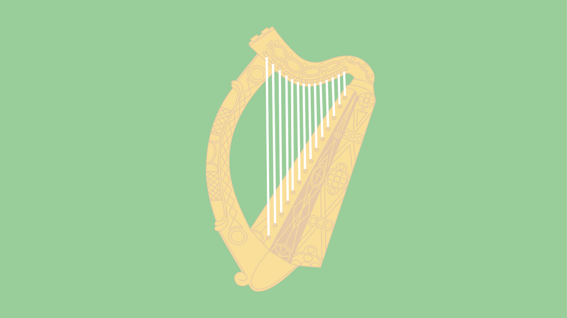


1884-1913
Chapter 3
SPORTING, CULTURAL AND SOCIAL MOVEMENTS IN 20TH CENTURY IRELAND
Sporting, Cultural and Social Movements in 20th Century Ireland
Strand Two: The History of Ireland
@MsDoorley

Slide 2

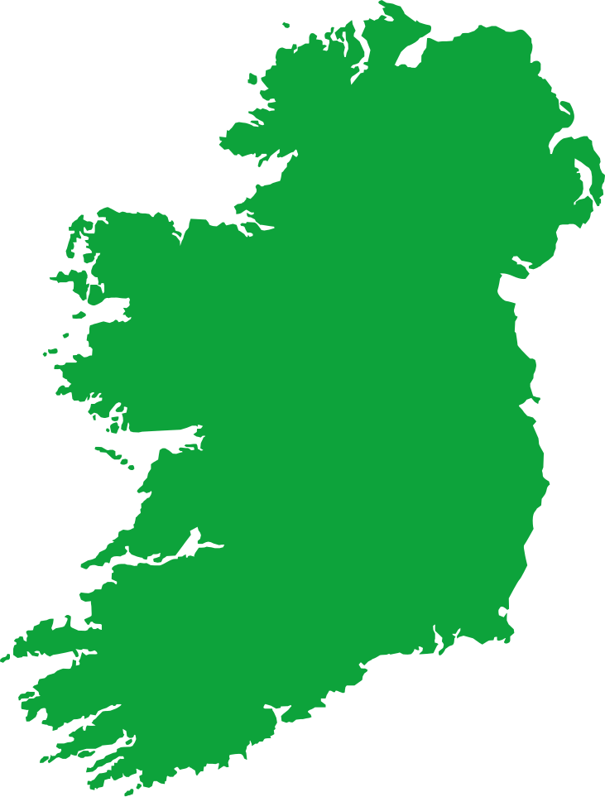

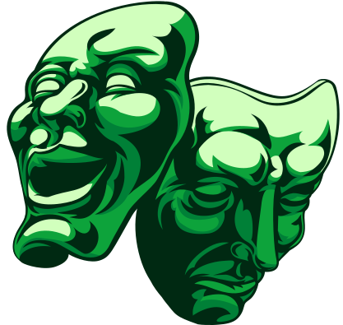





Chapter 18
SPORTING, CULTURAL AND SOCIAL MOVEMENTS IN IRELAND
The Irish Literary Society is formed by Douglas Hyde
The Irish Literary Theatre is established by WB Yeats, Lady Augusta Gregory and other members of the Protestant Ascendancy
James Larkin formed The Irish Transport and General Workers' Union
1884
1892
1893
1899
1904
1909
1913
Strand Two: The Nature of History
Chapter Eighteen: Sporting, Cultural and Social Movements in 20th Century Ireland
The Gaelic Athletic Association is founded in Thurles, Co. Tipperary
Eoin MacNeill and Douglas Hyde founded the Gaelic League
Irish Literary Theatre Society opened the Abbey Theatre.
The Dublin Strike & Lockout
Bloody Sunday results in the death of two demonstrators and hundreds other injured.
@MsDoorley

Slide 3
Learning Outcomes
2.10 EXAMINE how one sporting, cultural or social movement impacted on Irish life
1.7 DEVELOP historical judgements based on evidence about personalities, issues and events in the past, showing awareness of historical significance
1.9 DEMONSTRATE awareness of the significance of the history of Ireland and of Europe and the wider world across various dimensions, including political, social, economic, religious, cultural and scientific dimensions
Strand One: The Nature of History
Chapter Eighteen: Sporting, Cultural and Social Movements in 20th Century Ireland
@MsDoorley

Slide 4
Introduction
The three decades between 1884 and 1914 were a time of great change in Ireland. New cultural nationalist movements and organisations began during this period, such as the Gaelic League, the Irish Literary Revival, the GAA and the Irish Labour Movement. These movements had a large impact on Irish life and still play an important role in Irish society to this day.
Strand Two: The History of Ireland
Chapter Eighteen: Sporting, Cultural and Social Movements in 20th Century Ireland
@MsDoorley

Slide 5
1884-1913
Chapter 18
17.1: THE CAUSES OF THE GREAT FAMINE
18.1: cultural national movements
Strand Two: The History of Ireland
@MsDoorley

Slide 6
Cultural Nationalism
In the late 19th and 20th Centuries, a new type of nationalism began to emerge. Cultural nationalism focuses on promoting a national identity shaped by shared cultural traditions and language. Ireland had become increasingly anglicised following the Plantations and Act of Union in 1801. Anglicisation was the spreading of English culture throughout Ireland, leading to people speaking English, following English customs and playing English sports. To combat this, the Gaelic League and the Irish Literary Revival were established.
Strand Two: The History of Ireland
Chapter Eighteen: Sporting, Cultural and Social Movements in 20th Century Ireland
@MsDoorley

Slide 7
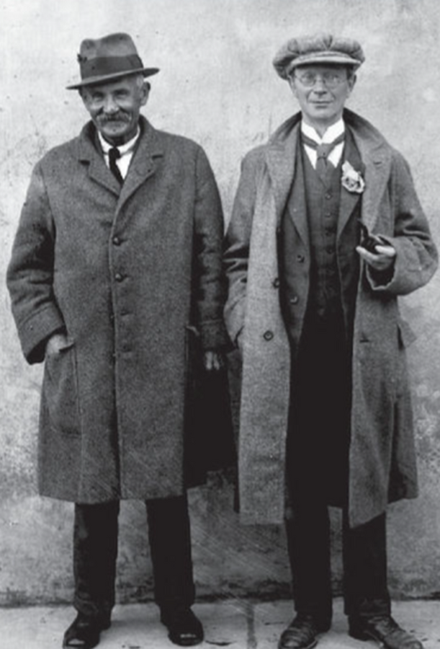
The Gaelic League
Between 1800 and 1900, the number of people who spoke Irish plummeted from 50% to 1%. Eoin MacNeill and Douglas Hyde founded the Gaelic League (now Conradh na Gaeilge), an organisation whose aim was to promote the Irish language. They felt that Irish identity was in danger of extinction, especially the Irish language. Hyde was elected the Gaelic League’s first president.
Successes included:
  Founding the Irish newspaper An Claidheamh Soluis (‘Sword of Light’) which published poems and short stories as gaeilge.
  They trained travelling teachers called timirí to teach Irish.
  They organised feiseanna and céilidhe to encourage Irish dancing and traditional Irish music.
  They aimed to increase the standard of written Irish throughout the country
  The Gaelic League renewed enthusiasm for the Irish language and helped slow its decline. Over time, many radical nationalists became linked such as Pádraig Pearse.
Strand Two: The History of Ireland
Chapter Eighteen: Sporting, Cultural and Social Movements in 20th Century Ireland
Diagram taken from Artefact, 2nd Edition by Eimear Jenkinson and Gregg O'Neill (educate.ie)
@MsDoorley

Slide 8
The Impact of the Gaelic League
The Gaelic League renewed enthusiasm for the Irish language and helped to slow its decline, contributing to the formation of Irish identity. Some of its most successful campaigns included: the acceptance by the Post Office of parcels & letters written in Irish; the recognition of St. Patrick’s Day as a national holiday. The introduction of Irish into the national school curriculum in 1904. By 1901, there were over 600 branches of the Gaelic League throughout Ireland, including in Belfast.
Although the Gaelic League was meant to be non-political but over time many radical nationalists such as Pádraig Pearse and Éamon de Valera were linked to it. By the early 1900s, the Irish language became associated with radical nationalism leading to many unionist members leaving. In 1903, Pearse became the editor of An Claidheamh Soluis. When the Irish Free State was founded in 1922, many of its members left to focus on political members; however, the Gaelic League continued to exist.
The Irish language movement had a strong role in the Building of the Irish Free State as Government documents were published in Irish as well as English while many English placenames reverted back to their original Irish name. The teaching of Irish was made compulsory in primary and secondary schools in 1928 and over the next decade, written Irish was standardised throughout the country.
The 1937 constitution, Bunreacht na hÉireann, declared Irish the official language of the state while English became the second language. While Irish governments have failed to restore Irish as a popular spoken language, the foundation of the Irish Free State saw a clear attempt to link the Irish language and Irish identity.
Strand Two: The History of Ireland
Chapter Eighteen: Sporting, Cultural and Social Movements in 20th Century Ireland
@MsDoorley

Slide 9
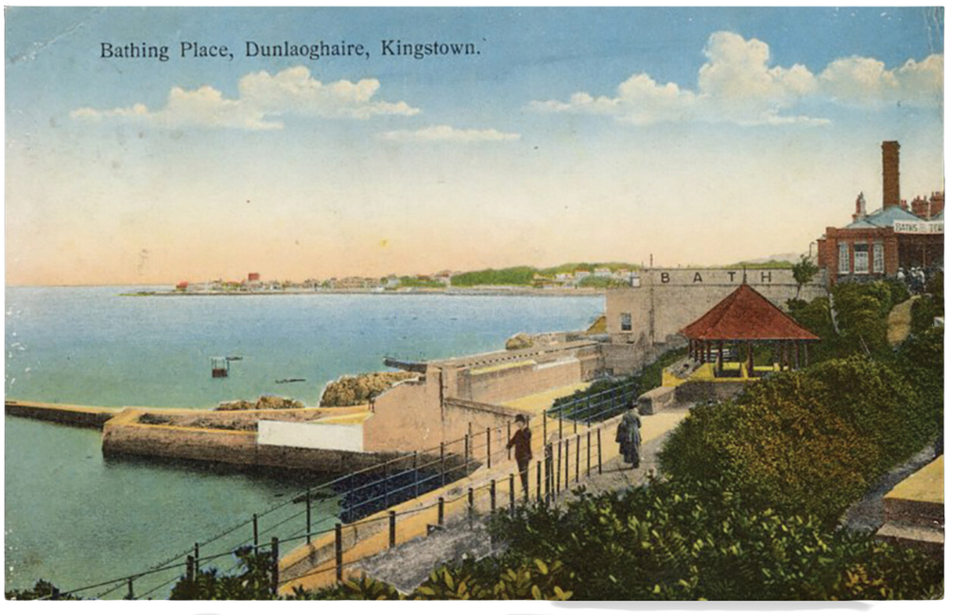
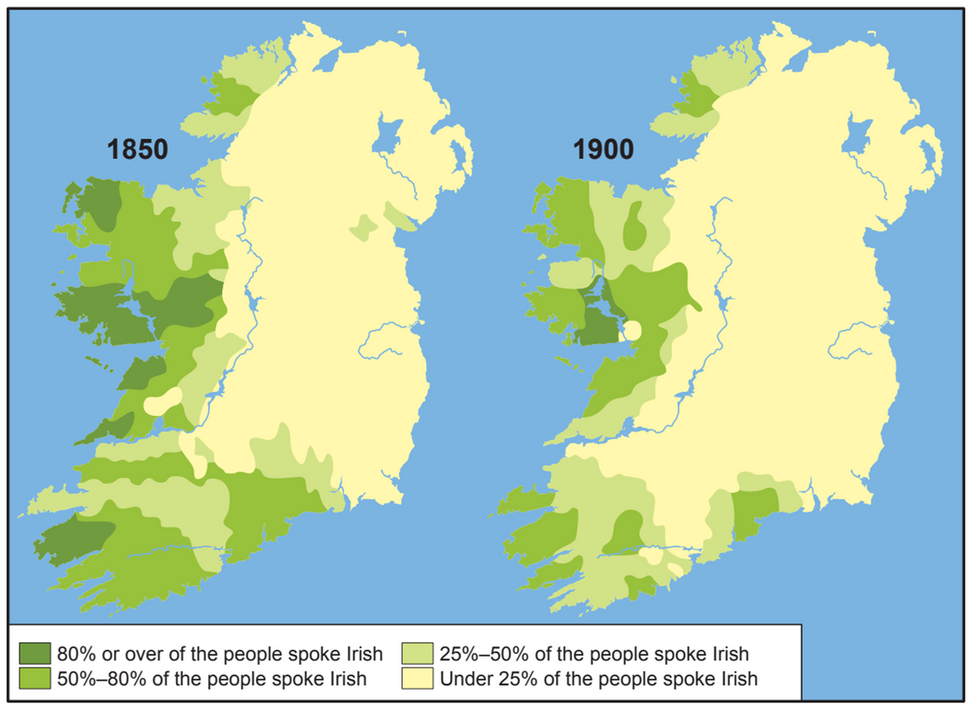
Did you know?
Mary E. L. Butler (Máire de Buitléir) was an Irish writer, Irish-language activist and member of the Gaelic League. She was a close friend of Arthur Griffith. In a letter of condolence to her sister, Griffith states that Mary was the first person to suggest 'Sinn Féin' to him for the name of the new organisation he founded in 1905.
Strand Two: The History of Ireland
Chapter Eighteen: Sporting, Cultural and Social Movements in 20th Century Ireland
Diagram taken from Artefact, 2nd Edition by Eimear Jenkinson and Gregg O'Neill (educate.ie)
@MsDoorley

Slide 10
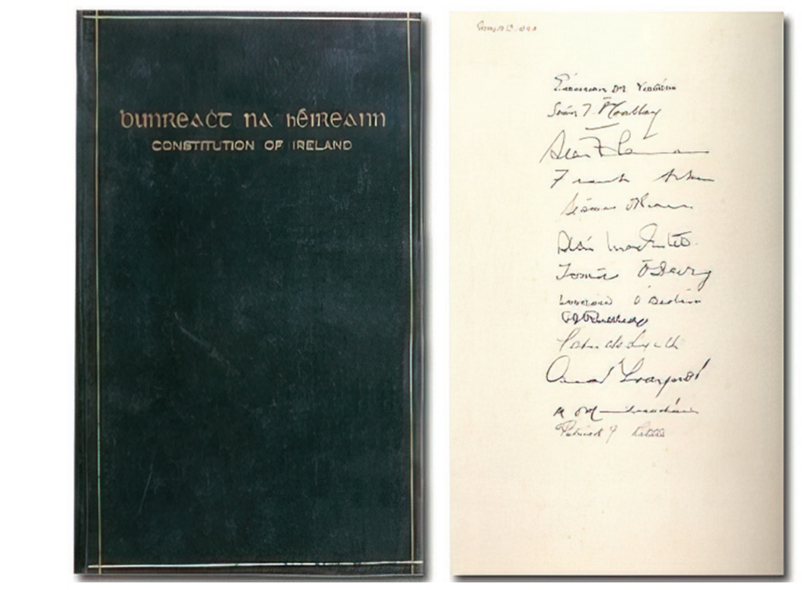

The Impact of the Gaelic League
Conradhna Gaeilge (modern day Gaelic League) still plays an important role in Irish culture and society to this day, protecting and promoting the Irish language. It played an important role in community campaigns that led to: the foundation of RTÉ Raidió na Gaeltachta in 1972 and TG4 in 1996.
Strand Two: The History of Ireland
Chapter Eighteen: Sporting, Cultural and Social Movements in 20th Century Ireland
Diagram taken from Artefact, 2nd Edition by Eimear Jenkinson and Gregg O'Neill (educate.ie)
@MsDoorley

Slide 11
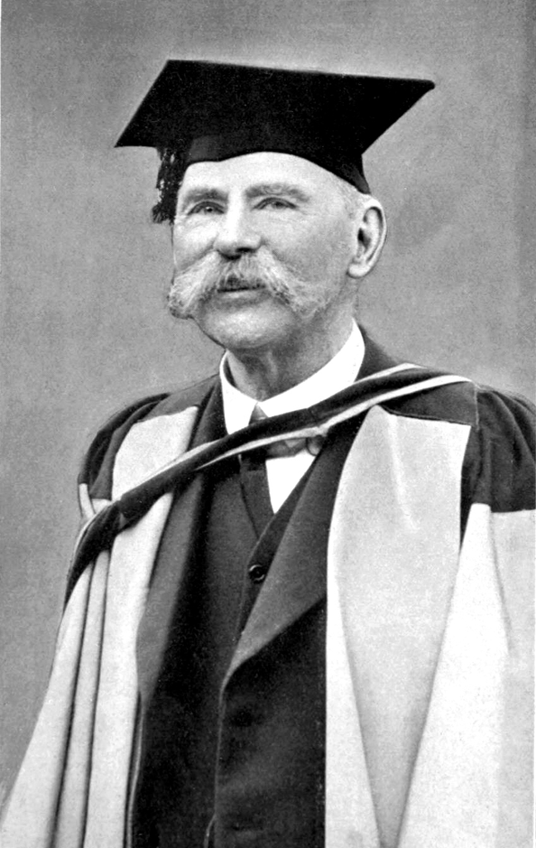
Douglas Hyde, 1860-1949
Douglas Hyde, from Co. Roscommon, was a founder of the Gaelic League in 1893. He was appointed its president and worked to preserve and revive the Irish language. He resigned from the Gaelic League when the IRB changed the constitution in favour of promoting Irish independence. He was elected to Seanad Éireann in 1925 for a brief period of time before becoming Professor of Irish at University College Dublin. Hyde served as the first President of Ireland from 1938 until 1945.
Strand Two: The History of Ireland
Chapter Eighteen: Sporting, Cultural and Social Movements in 20th Century Ireland
Diagram taken from Artefact, 2nd Edition by Eimear Jenkinson and Gregg O'Neill (educate.ie)
@MsDoorley

Slide 12
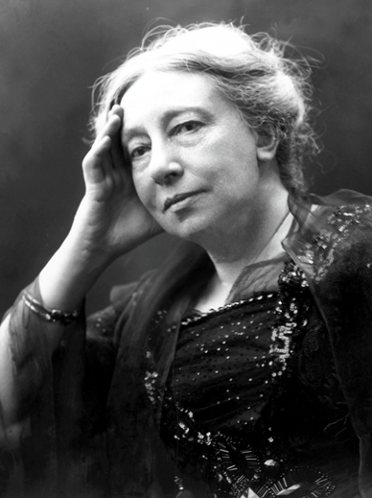
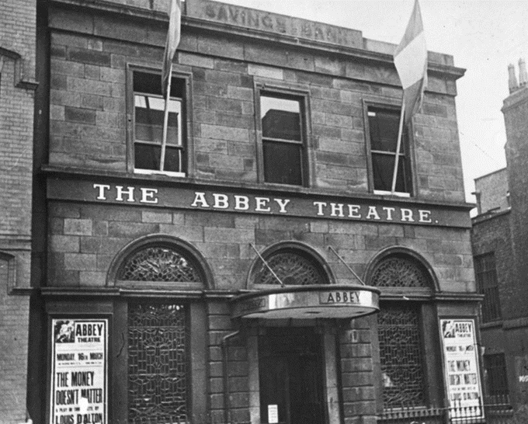
The Irish Literary Revival
The Irish Literary Revival was a moment that aimed to promote Irish literature and coincided with a renewed interest in Gaelic Irish cultural heritage. A new form of literature emerged; Irish myths and legends as well as contemporary Irish society but written in English. William Butler Yeats was one of the central figures in the moment, using Irish myths and folklore in much of his work. Politically, Yeats was sympathetic towards the IRB but he only acted through his writing.
Douglas Hyde and others formed the Irish Literary Society in 1892 to promote new literary works. In 1899, Yeats – along with other members of the Protestant Ascendancy such as Lady Augusta Gregory – established the Irish Literary Theatre (The Irish National Theatre Society). In 1904, they opened the Abbey Theatre in Dublin.
Irish writers and plays were supported and staged such as Katheleen Ní Houlihan and The Playboy of the Western World. These plays and the popularity of the Abbey Theatre helped to re-establish a sense of Irish identity.
Strand Two: The History of Ireland
Chapter Eighteen: Sporting, Cultural and Social Movements in 20th Century Ireland
@MsDoorley

Slide 13
The Impact of the Gaelic League
The Irish Literary Movement sought to reclaim Ireland's cultural identity in the face of prevalent English influence. Pioneered by influential figures like W.B. Yeats, Lady Gregory, and J.M. Synge, this cultural renaissance emphasized the depth and richness of Irish myths, legends, and folklore. Their literary efforts served to spotlight a unique heritage that was on the brink of obscurity, ensuring its survival for future generations.
A monumental achievement of this era was the establishment of the Abbey Theatre in 1904 by Yeats and Lady Gregory. This theatre became an epicentre for Irish plays that echoed the nation's culture, history, and present-day challenges. By offering a stage to voices championing Irish identity, the Abbey Theatre fortified the cultural spirit of the country and distinguished it from British narratives.
While the primary focus of the Irish Literary Movement was cultural, it inadvertently dovetailed with the growing fervor of political nationalism. The renewed pride in Irish identity, propagated through literature, made it a symbolic beacon for those advocating for Ireland's independence from British rule. This synergy of culture and politics solidified literature's role as a powerful tool for national discourse.
Education in Ireland began to reflect the aspirations of the movement as Irish literary works were incorporated into school curricula. This integration ensured that the younger generation remained anchored to their cultural roots, fostering a sense of belonging and identity. The foundation set by this movement also heralded the rise of literary giants like Samuel Beckett, James Joyce, and Sean O’Casey, who further elevated Ireland's position in the global literary landscape.
Strand Two: The History of Ireland
Chapter Eighteen: Sporting, Cultural and Social Movements in 20th Century Ireland
@MsDoorley

Slide 14
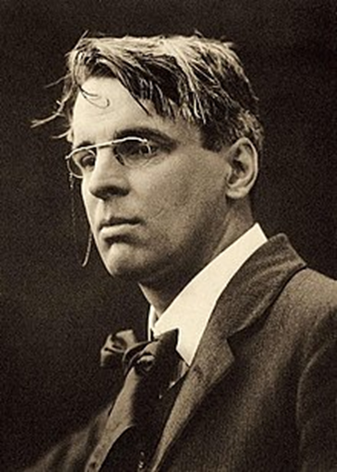
William Butler Yeats, 1865-1939
W.B. Yeats, hailing from Co. Sligo, was a pivotal figure in the Irish Literary Movement of the late 19th and early 20th centuries. As a poet, playwright, and senator, Yeats championed the revival of Irish literature, folklore, and cultural identity. His works, such as "The Tower" and "The Winding Stair," reflect a deep connection with Irish themes and mysticism. Beyond his literary contributions, he was also instrumental in the establishment of the Abbey Theatre in 1904. Yeats was awarded the Nobel Prize in Literature in 1923, recognizing his indelible contributions to literature. He served as a senator in the Irish Free State from 1922 to 1928, further emphasizing his deep commitment to Ireland's cultural and political landscape.
Strand Two: The History of Ireland
Chapter Eighteen: Sporting, Cultural and Social Movements in 20th Century Ireland
@MsDoorley

Slide 15
Checkpoint pg. 237 (Artefact, 1st Edition)
  Explain the terms; cultural nationalism and anglicisation.
  Why was the Gaelic League founded?
  How did the Gaelic League try to revive interest in the Irish language?
  What was the Irish Literary Revival?
  How did the Irish Literary Revival promote Irish writers and culture?
  Name two impact of the Gaelic League on Irish life.
Strand Two: The Nature of History
Chapter Eighteen: Sporting, Cultural and Social Movements in 20th Century Ireland
@MsDoorley

Slide 16
1884-1913
Chapter 18
18.2: A SPORTING MOVEMENT: THE GAA
18.2: a sporting movement: the GAA
Strand Two: The History of Ireland
@MsDoorley

Slide 17
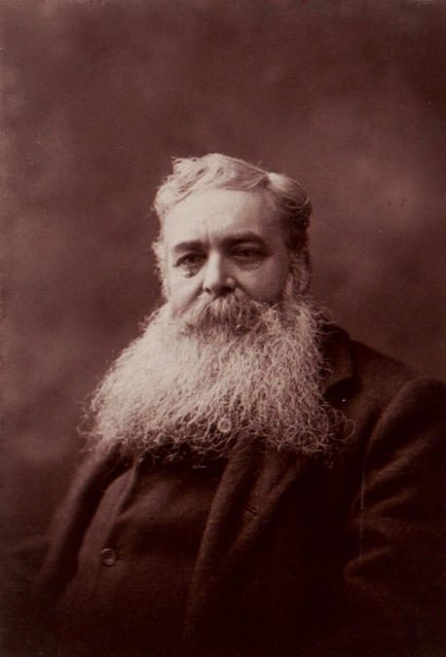
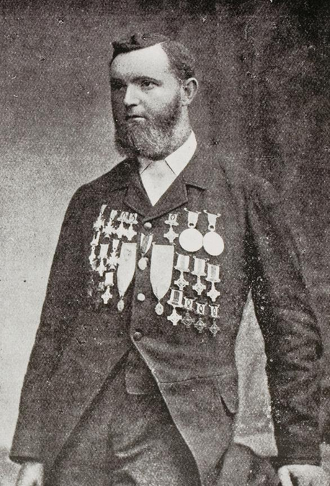
The Foundation of the GAA
By 1880, English sports such as tennis, cricket, soccer and rugby had become very popular in Ireland. Each was well organised and had clear rules. At the same time, Irish sports such as hurling and Gaelic football were in decline and even unknown in some areas of the country. They were poorly organised and different rules for different parts of the country.
A man named Michael Cusack was concerned about the state of Irish sports and thus called a meeting in Hayes Hotel in Thurles, Co. Tipperary on 1st November 1884. Seven men were present as the GAA (Gaelic Athletic Association) was founded. The Association would deal with hurling, Gaelic football, handball, athletics and weightlifting. The athlete Maurice Davin was elected president and Cusack became secretary. People such as Charles Stewart Parnell, Michael Davitt and Archbishop Thomas Croke became patrons of the GAA. This showed that the Home Rule Party, the IRB, the Land League and the Catholic Church all supported the GAA.
Strand Two: The History of Ireland
Chapter Eighteen: Sporting, Cultural and Social Movements in 20th Century Ireland
Diagram taken from Artefact, 2nd Edition by Eimear Jenkinson and Gregg O'Neill (educate.ie)
@MsDoorley

Slide 18
The Development of the GAA
  The GAA quickly began to organise itself and to formalise its rules, receiving huge nationwide support.
  New rules were agreed for hurling, football, athletics and weightlifting in February 1885.
  Clubs were formed all over the country and also abroad (e.g. London and New York)
  Games were organised for Sundays (never allowed before)
  The GAA banned people from playing Gaelic sports if they also played or attended foreign sports (rugby, cricket, soccer or tennis). Many disagreed with this decision.
  The first All-Ireland Championship among parish teams was held in 1887.
The IRB saw the GAA as a perfect source of fighters for a future rebellion and infiltrated the association. While the founders of the GAA were nationalists, there was tension over the IRB’s presence. Some were constitutional, the rest were radical. This divide damaged the association. A further split occurred following the scandals about Parnell and Katharine, causing many members to leave the GAA.
Did you know?
A controversial 1885 decision to ban members of the GAA from playing 'foreign games' was made a compulsory ban in 1902. This Rule 27, known as 'the Ban', prohibited GAA members from playing or watching 'foreign games', specifically soccer, rugby, cricket and hockey, and it remained in place until 1971. Limiting the spread of these games was believed to be a method of protecting Irish culture.
Strand Two: The History of Ireland
Chapter Eighteen: Sporting, Cultural and Social Movements in 20th Century Ireland
Diagram taken from Artefact, 2nd Edition by Eimear Jenkinson and Gregg O'Neill (educate.ie)
@MsDoorley

Slide 19
The Development of the GAA
In the early 1900s the GAA became popular again. This was because:
  The IRB was not as prominent during this time
  The GAA had created links with organisations such as the Gaelic League by actively promoting the Irish language
  The new rules appealed to people
  Croke Park (named after Archbishop Croke), known as Jones’ Roadat the time, was bought in 1913, providing the GAA with new grounds for major events such as finals.
Strand Two: The History of Ireland
Chapter Eighteen: Sporting, Cultural and Social Movements in 20th Century Ireland
Diagram taken from Artefact, 2nd Edition by Eimear Jenkinson and Gregg O'Neill (educate.ie)
@MsDoorley

Slide 20
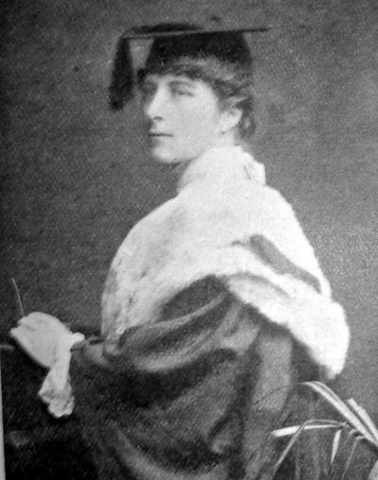
Máire Ní Chinnéide, 1879-1967
Born in Rathmines in Dublin, Máire Ní Chinnéide learned to speak Irish in Ballyoumey in Cork and won the first Irish scholarship from the Royal University. She joined the Gaelic League and wrote several plays for children in Irish. To increase the opportunities for women in the Gaelic Revival, she helped write the rules for camogie (with a lighter ball and smaller pitch than hurling) and was elected the first president of the Camogie Association in 1904. The game grew in popularity over the following decades and the first All Ireland final was held in 1932. Ní Chinnéide fought with Cumann na mBan in the War of Independence and took the pro-Treaty side in the Civil War.
Strand Two: The History of Ireland
Chapter Eighteen: Sporting, Cultural and Social Movements in 20th Century Ireland
@MsDoorley

Slide 21
The Impact of the GAA
The GAA was instrumental in reviving Irish sports, providing a social and physical outlet for people from various social classes. Middle-class membership rose to match that of the working class. It linked sport and nationalism in a way that had not been done before. It served as a recruitment ground for Home Rule and the IRB. Many members would go on to be involved in the Easter Rising and War of Independence.
Nowadays, the GAA defines itself as 'a community-based amateur organisation promoting Gaelic games, culture and lifelong participation'. The GAA has remained an amateur association since its foundation. Its basic aim is to ‘strengthen the national identity’ through its primary purpose to promote and control the national games of hurling, gaelic football, handball and rounders. It also aims to:
  Actively support the Irish language and Irish culture
  Promote the aims of the GAA abroad
  Support the promotion of camogie and ladies’ Gaelic football
  Support Irish industry
The GAA has over 2,200 clubs in all 32 counties of the island of Ireland with another 300+ clubs affiliated to the GAA in Europe, the USA, Canada, Asia, Australia, New Zealand and Britain.
Strand Two: The History of Ireland
Chapter Eighteen: Sporting, Cultural and Social Movements in 20th Century Ireland
@MsDoorley

Slide 22
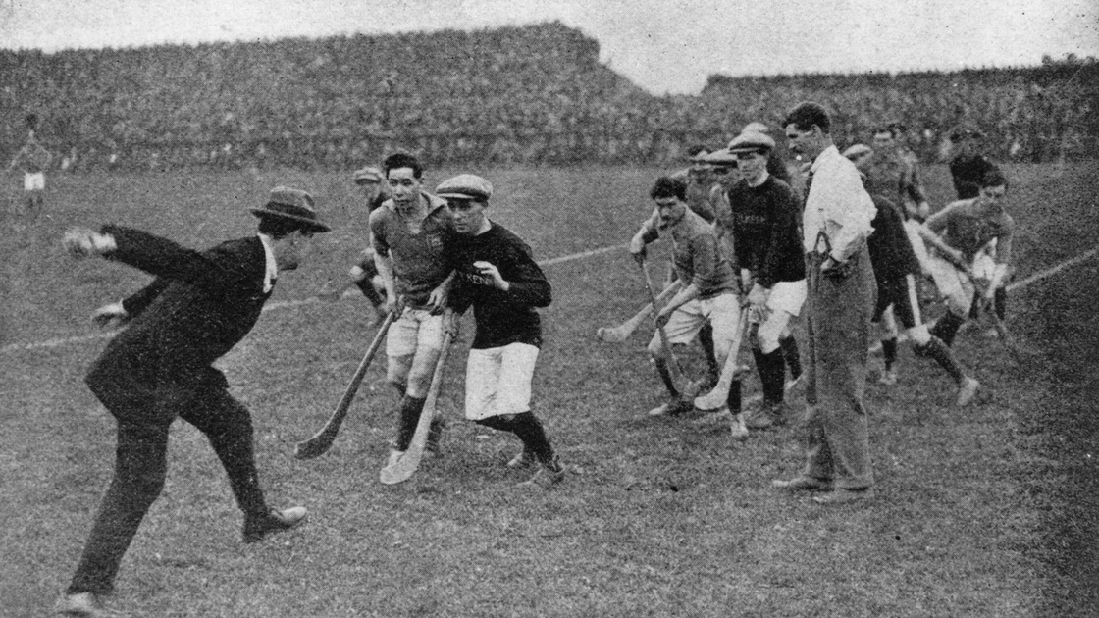
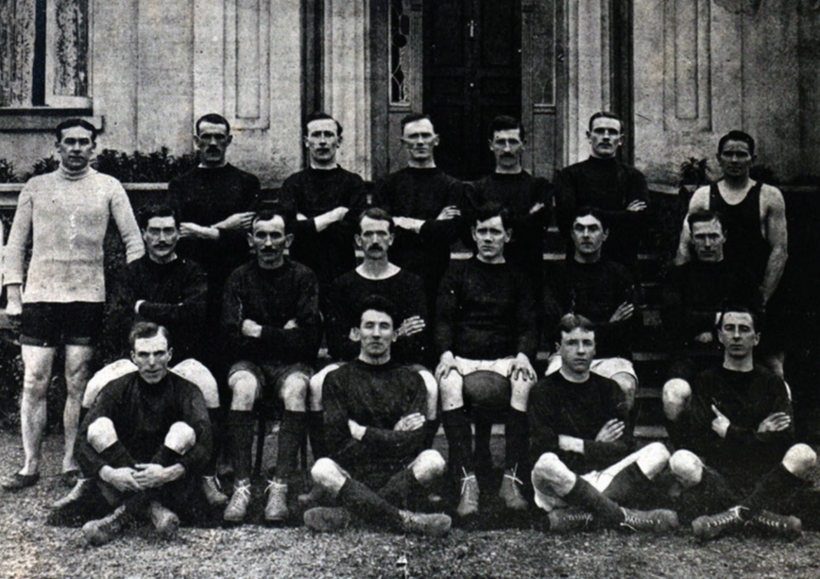
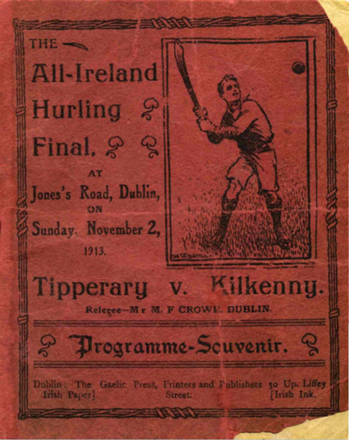
Strand Two: The History of Ireland
Chapter Eighteen: Sporting, Cultural and Social Movements in 20th Century Ireland
Diagram taken from Artefact, 2nd Edition by Eimear Jenkinson and Gregg O'Neill (educate.ie)
@MsDoorley

Slide 23
Checkpoint pg. 194 (Artefact, 2nd Edition)
  Briefly describe the state of sports in Ireland in the days before the GAA.
  Where was the GAA founded and who founded it?
  Name two significant organisations that supported the GAA/
  How did the GAA develop? Give two examples.
  Why did the GAA begin to decline in the final years of the nineteenth century?
  Give two aims of the GAA today.
  Give two impacts of the GAA on Irish life.
Strand Two: The Nature of History
Chapter Eighteen: Sporting, Cultural and Social Movements in 20th Century Ireland
@MsDoorley

Slide 24
Checkpoint pg. 194 (Artefact, 2nd Edition)
  English sports such as tennis, cricket, soccer and rugby had become very popular in Ireland. Each was well organised and had clear rules. Irish sports such as hurling and Gaelic football were in decline and were even unknown in some areas. They were poorly organised and people around the country played by different rules.
  In Hayes Hotel in Thurles, Co. Tipperary. It was founded by Michael Cusack and six other men.
  Any two of: the Home Rule Party; the IRB; the Land League; the Catholic Church.
  The GAA quickly began to organise itself and to formalise its rules; it received huge nationwide support; new rules were agreed for hurling, football, athletics and weightlifting in February 1885; clubs were formed throughout the country and abroad; games were organised for Sundays; the GAA banned people from playing Gaelic sports if they also played or attended foreign sports.
  The founders of the GAA were nationalists but there was a split over the IRB’s presence in the organisation. Some members believed in achieving nationalism through political means, while others believed in achieving nationalism through the physical methods/means of the IRB. Many members left the GAA.
  Any two of: actively support the Irish language and Irish culture; promote the aims of the GAA abroad; support the promotion of camogie and ladies’ Gaelic football; support Irish industry.
  Any two of: revived Irish sports; linked sport and nationalism; provided a social and physical outlet for people; strengthened national identity; supported the Irish language and Irish culture, etc.
Strand Two: The Nature of History
Chapter Eighteen: Sporting, Cultural and Social Movements in 20th Century Ireland
@MsDoorley

Slide 25
1884-1913
Chapter 18
18.3 A SOCIAL MOVEMENT: THE IRISH LABOUR MOVEMENT
18.3 a social movement: the irish labour movement
Strand Two: The History of Ireland
@MsDoorley

Slide 26
Working and Living Conditions
Working and living conditions for Dublin’s working class in the early 1900s were very poor with around 25,000 of the city’s 40,000 workers being unskilled (usually dockers and carters on Dublin’s port). Unskilled workers worked on a casual basis with no permanent work making their wages low, providing no job security and having no unions to protect their rights. Dublin’s working class had the worst of the city’s housing conditions, considered to be the worst city slums in Europe at the time. It is believed that one-third of Dublin’s population lived in tenements (buildings that housed a large number of families in separate rooms). They quickly became overcrowded while diseases such as tuberculosis and whooping cough were widespread and infant mortality was very high.
Strand Two: The History of Ireland
Chapter Eighteen: Sporting, Cultural and Social Movements in 20th Century Ireland
Diagram taken from Artefact, 2nd Edition by Eimear Jenkinson and Gregg O'Neill (educate.ie)
@MsDoorley

Slide 27
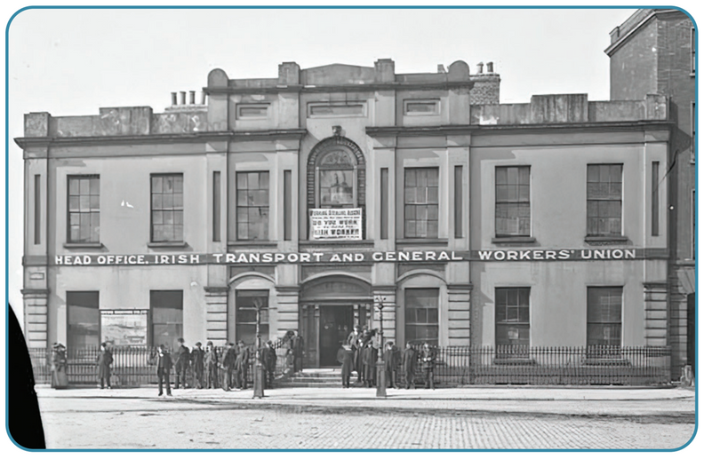
The Irish Transport and General Workers’ Union
In January 1909, James “Jim” Larkin formed an Irish-based trade union, The Irish Transport and General Workers’ Union (ITGWU) in response to the appalling working and living conditions. The union’s headquarters were at Liberty Hall in Dublin. Larkin believed in syndicalist socialism (workers stood a better chance of improving their working conditions if they were part of a union, which would then work towards bring industries under the management and ownership of the workers).
In 1910, Larkin was joined by James Connolly, a Scottish socialist whose parents were Irish. Connolly became the organiser of the ITGWU in Belfast, leading a successful campaign there in the textile mills. From 1911 onwards, the ITGWU organised a number of successful strikes. Together, Larkin and Connolly began the labour movement in Ireland with membership growing rapidly. In 1911, they launched a newspaper called The Irish Worker.
Strand Two: The History of Ireland
Chapter Eighteen: Sporting, Cultural and Social Movements in 20th Century Ireland
Diagram taken from Artefact, 2nd Edition by Eimear Jenkinson and Gregg O'Neill (educate.ie)
@MsDoorley

Slide 28
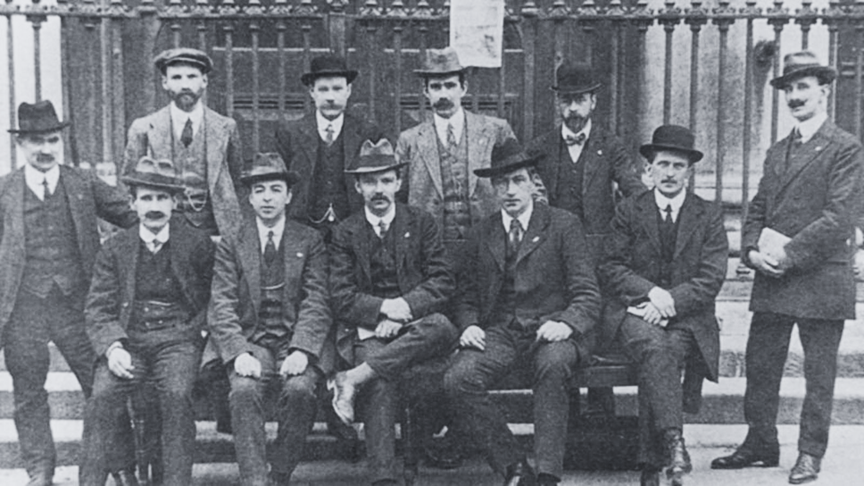
The Irish Labour Party
Connolly, Larkin and William O’Brien (leader of the Tailors’ Union) established the Irish Labour Party in 1912 in Clonmel, Co. Tipperary. The party was the political wing of the Trades Union Congress (TUC), the governing body for Irish trade unions. The aim of the Irish Labour Party was to express the concerns of the workers politically.
Strand Two: The History of Ireland
Chapter Eighteen: Sporting, Cultural and Social Movements in 20th Century Ireland
Diagram taken from Artefact, 2nd Edition by Eimear Jenkinson and Gregg O'Neill (educate.ie)
@MsDoorley

Slide 29
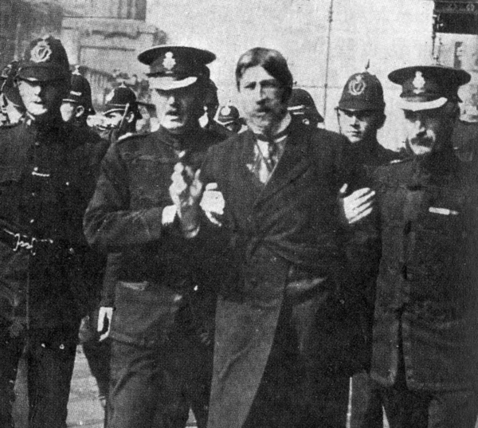
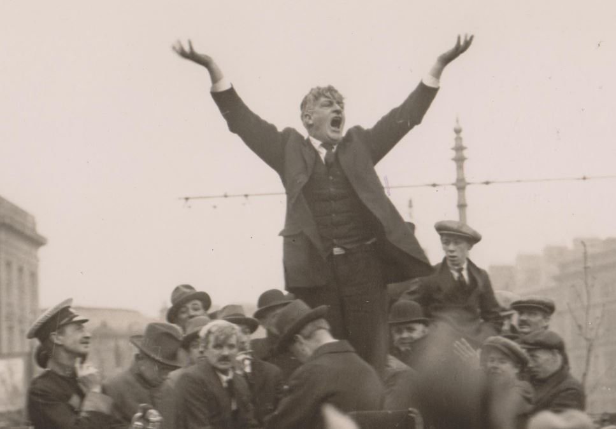
The 1913 Strike and Lockout
The TUC raised £100,000 to provide for struggling Irish workers and their families with food and clothing. The British government’s Asquith Enquiry called for an end to the Strike and Lockout in September 1913 but it continued as the ITGWU and Murphy could not reach a compromise. On the 13 November 1913, Connolly formed the Irish Citizen Army (ICA) to protect striking workers – the ICA would go on to play a key role during the 1916 Rising.
Strand Two: The History of Ireland
Chapter Eighteen: Sporting, Cultural and Social Movements in 20th Century Ireland
Diagram taken from Artefact, 2nd Edition by Eimear Jenkinson and Gregg O'Neill (educate.ie)
@MsDoorley

Slide 30
The 1913 Strike and Lockout
The workers lost the support of many Irish Catholics who did not agree with Larkin’s ideals. The British TUC also disagreed with Larkin’s sympathetic strikes. By January 1914, many began to return to work with Larkin telling workers to end their strike on the 18th January. Many had to leave the ITGWU in order to return to work. The Irish Labour Movement suffered with the loss of membership. However, employers knew they could not challenge union membership in this way again. Membership of the ITGWU began to increase again and by 1919, it surpassed that of 1913.
Strand Two: The History of Ireland
Chapter Eighteen: Sporting, Cultural and Social Movements in 20th Century Ireland
@MsDoorley

Slide 31
The Irish Labour Movement after the 1913 Strike and Lockout
After the 1913 Strike and Lockout, the Irish Labour Movement continued to have an impact on Ireland, north and south.
  During the War of Independence (1919-1921), the Irish Trades Union Congress coordinated one-day strikes in favour of the release of political prisoners – sympathetic action was taken by railwaymen who refused to transport British troops.
  The Irish Congress of Trade Unions (ICTU) was formed in 1959 by the merging of the Irish Trades Union Congress and the Congress of Irish Unions into one organisation representing both the north and south of the country.
  During the Northern Ireland Civil Rights Campaign in 1964-1965, the ICTU led a campaign using the slogan ‘British rights for British citizens’ to encourage the introduction of ‘one man, one voice’.
  In 1972, Irish trade unions and the Labour Party were against the terms of entry into the EEC, believing Irish industry would collapse if the Irish market was opened up to multinational companies.
  In 1990, the Services, Industrial, Professional and Technical Union (SIPTU) was established by the merging of the country’s two largest unions (the ITGWU and the Federated Workers’ Union of Ireland – both were founded by Larkin). SIPTU remains the largest union in Ireland with over 180,000 members.
  The Labour Party continues to be the political arm of the Irish trade union and labour movement while its aim remains to represent workers’ interests in the Dáil and on a local level.
Strand Two: The History of Ireland
Chapter Eighteen: Sporting, Cultural and Social Movements in 20th Century Ireland
@MsDoorley

Slide 32
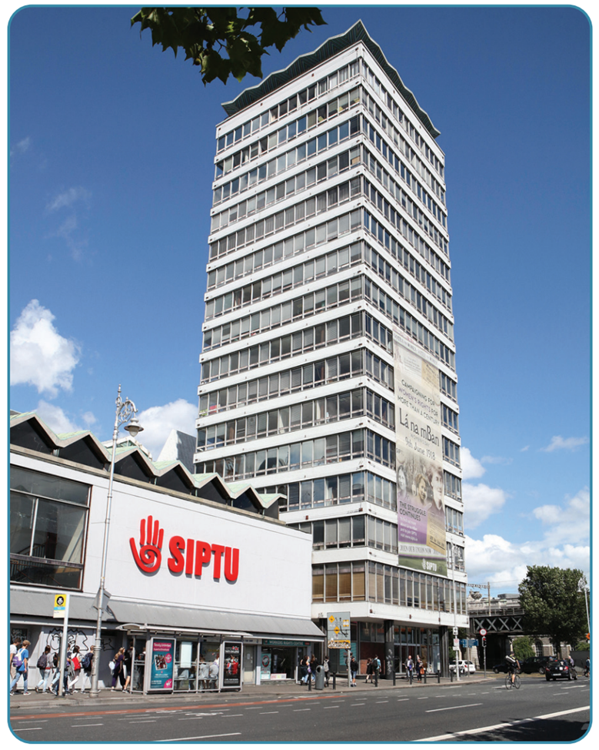
Strand Two: The History of Ireland
Chapter Eighteen: Sporting, Cultural and Social Movements in 20th Century Ireland
Diagram taken from Artefact, 2nd Edition by Eimear Jenkinson and Gregg O'Neill (educate.ie)
@MsDoorley

Slide 33
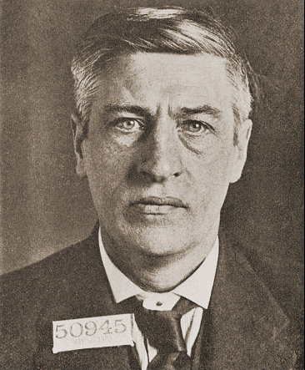
James “Jim” Larkin, 1876-1947
James “Jim” Larkin was born in Liverpool to Irish parents. In 1901, he joined the National Union of Dock Labourers (NUDL) in Britain. In 1905, he was sent to Belfast to organise the city’s dockers. He founded the Irish Transport and General Workers Union (ITGWU). The strikes organised by the ITGWU in 1913 resulted in a lockout. After the defeat of the workers in 1914, Larkin emigrated to the USA. He returned to Ireland in 1923, when he formed the Irish Worker League, a communist organisation. Larkin was elected to the Dáil three times, in 1927, 1937 and 1947. He died in 1947 and is buried in Glasnevin Cemetery.
Strand Two: The History of Ireland
Chapter Eighteen: Sporting, Cultural and Social Movements in 20th Century Ireland
Diagram taken from Artefact, 2nd Edition by Eimear Jenkinson and Gregg O'Neill (educate.ie)
@MsDoorley

Slide 34
Checkpoint pg. 198 (Artefact, 2nd Edition)
  Briefly describe the working and living conditions for Dublin’s working class in the early 1900s.
  Who founded the Irish Transport and General Workers’ Union (ITGWU) and why?
  Who founded the Irish Labour Party and what was its aim?
  Describe two events from the 1913 Strike and Lockout.
  Who founded the Irish Citizen Army and why?
  How did the 1913 Strike and Lockout end?
  Briefly describe the Irish Labour Movement after the 1913 Strike and Lockout.
  Give two impacts of the Irish Labour Movement on Irish Life.
Strand Two: The Nature of History
Chapter Eighteen: Sporting, Cultural and Social Movements in 20th Century Ireland
@MsDoorley

Slide 35
Checkpoint pg. 198 (Artefact, 2nd Edition)
  Working and living conditions for Dublin’s working class in the early 1900s were very poor. Unskilled workers (25,000 of the city’s 40,000 workers) found work around Dublin port as dockers and carters. Wages were low and there was no job security. One third of Dublin’s population lived in tenements. Whole families lived in just one room. Diseases were widespread.
  James (Jim) Larkin founded the trade union, The Irish Transport and General Workers’ Union (ITGWU), in response to the appalling working and living conditions of Dublin’s working class.
  James Connolly, Jim Larkin and William O’Brien established the Irish Labour Party. Its aim was to express the concerns of the workers politically.
  Any two of: on 26 August the strike of the Tramways Company began. Many tram workers feared being sacked.
    Murphy brought in extra workers, who were protected by the Dublin Metropolitan Police. The strike was a failure.
    Larkin and other organisers were arrested. Murphy locked out (sacked) employees who were members of the ITGWU. On 31 August 1913 – Bloody Sunday, Larkin addressed a crowd of 10,000 people on O’Connell Street from the Imperial Hotel in disguise, as there was a warrant for his arrest. He was arrested by the Dublin Metropolitan Police. The crowd protested and the police baton-charged the crowd. Two demonstrators were killed and hundreds were wounded, including police.
Strand Two: The Nature of History
Chapter Eighteen: Sporting, Cultural and Social Movements in 20th Century Ireland
@MsDoorley

Slide 36
Checkpoint pg. 198 (Artefact, 2nd Edition)
  5. James Connolly formed the Irish Citizen Army (ICA) to protect the striking workers.
  6. By January 1914, many began to return to work. On 18 January, Larkin told the workers to end their strike. Many had to leave the ITGWU.
  7. During the War of Independence, the Irish Trades Union Congress coordinated one-day strikes in favour of the release of political prisoners. Sympathetic action was taken by railwaymen, who refused to transport British troops. The Irish Congress of Trade Unions (ICTU) was formed in 1959. During the Northern Ireland civil rights campaign in 1964–1965, the ICTU led a campaign using the slogan ‘British rights for British citizens’.
  8. Any two of: establishment of trade unions; strong trade union links both north and south of the country; 1913 Strike and Lockout; creation of the Irish Citizen Army and links to nationalism; improvements to working conditions; establishment of the Labour Party in Ireland.
Strand Two: The Nature of History
Chapter Eighteen: Sporting, Cultural and Social Movements in 20th Century Ireland
@MsDoorley

Slide 37
1884-1913
Chapter 18
18.5: SUMMARY
18.5: summary
Strand Two: The History of Ireland
@MsDoorley

Slide 38
In this chapter, we have learned that...
  The Gaelic League, the Irish Literary Movement and the GAA were at the forefront of cultural nationalism at this time.
  The Gaelic League renewed enthusiasm for the Irish language and helped to slow its decline.
  During this period, the GAA’s ties to various nationalist groups were extremely close. The IRB sought new members within the local GAA clubs.
  The Irish Labour Movement grew during the early 1900s with the formation of the ITGWU, the Labour Party and the Irish Citizen Army.
  The Gaelic League, the Irish Literary Movement and the Irish Labour Movement have each had a significant impact on Irish life.
Strand Two: The History of Ireland
Chapter Eighteen: Sporting, Cultural and Social Movements in 20th Century Ireland
@MsDoorley

Slide 39
Reflecting on... Sporting, Cultural and Social Movements in 20th Century Ireland
The years 1884-1914 saw significant change in Ireland, in particular politically. A revival of uniquely Irish culture was also taking place at this time, as the Gaelic League tried to save the Irish language from decline, the Irish Literary Revival promoted Irish identity through literature and the GAA linked sports and nationalism across the island. The Irish Labour Movement was also born during this period. The Gaelic League, Irish Literary Revival, the GAA and the Irish Labour Movement continue to have an impact on Ireland today, showing their importance in the history of Ireland and the creation and building of the Irish Free State.
Strand Two: The History of Ireland
Chapter Eighteen: Sporting, Cultural and Social Movements in 20th Century Ireland
@MsDoorley

Slide 40
SEC Examination Questions
2023 SEC Q8
Strand Two: The History of Ireland
Chapter Eighteen: Sporting, Cultural and Social Movements in 20th Century Ireland
@MsDoorley

Slide 41
Project
Guidelines:
  Length: The depth of your project should reflect about 2-3 weeks of work.
  Sources: Use at least three different sources for your research. These can be books, scholarly articles, or reputable online resources.
  Citations: All information and images that are not your own should be properly cited.
  Mediums: You may choose to present your project in one of the following ways:
    Poster: Your poster should be informative and visually engaging.
    Minecraft or Lego Model: If choosing this option, please also include a brief report explaining your model.
    Painting/Drawing: Your artwork should be accompanied by a description.
    Recycled Materials: Create your model using recycled materials and provide an explanation of your creative process.
Assessment:
Your projects will be assessed based on:
  Research and Content
  Creativity and Presentation
  Understanding of Context
  Adherence to Guidelines
Strand Two: The History of Ireland
Chapter Eighteen: Cultural, Sporting and Social Movements in Ireland
@MsDoorley

Slide 42
Project
Historical Sites
Historical Figures
Croke Park, Dublin, Republic of Ireland
Abbey Theatre, Dublin, Republic of Ireland
Liberty Hall, Dublin, Republic of Ireland
Shelbourne Park, Dublin, Republic of Ireland
Queen's University, Belfast, Northern Ireland
Michael Cusack
Patrick Nally
Maurice Davin
Archbishop Croke
Frank Dineen
Paddy Kennedy
Mick O’Connell
James McCartan
Jimmy Keaveney
Enda Colleran
Billy Morgan
Christy Ring
DJ Carey
Eddie kheer
Mick Mackey
Angela Downey
Juliet Murphy
Briege Corkery
Marina Barry Deirdre Hughes
Strand Two: The History of Ireland
Chapter Eighteen: Cultural, Sporting and Social Movements in Ireland
@MsDoorley

